Slide 1
Mobile-Based Attendance Management System
Leveraging Facial Recognition & Geofencing
Presented by Group 12

Slide 2
Agenda
1. Problem & Objectives
2. Stakeholders & Pain Points
3. Requirement Gathering
4. Competitor & SWOT Analysis
5. Technology Stack
6. Survey Insights
7. Recommended Solution
8. Security & Privacy
9. Conclusion

Slide 3
Problem & Objectives
Current Issues:
51% wrongful absences (manual errors).
80% proxy cheating (impersonation).
10–15 mins/lecture wasted.
Solution:
Facial Recognition + Geofencing for automated, secure attendance.
Objectives:
Automate attendance, reduce errors, integrate analytics.

Slide 4
Stakeholders & Pain Points

Slide 5
Stakeholder | Role
Students | Users
Lecturers | Validators
IT Admin | Maintainers
Academic Admin | Decision Makers
Key Concerns
Privacy, accuracy in poor ligthing
Time waste, cheating
Security, system compatibility
Policy Compliance, scalability

Slide 6
Requirement Gathering Methods

Slide 7
Surveys: 39 students, 1 lecturer.
Interviews: 3 students, 3 lecturers (1 Administrator).
Competitive Analysis: TrackCC, MyAT, Palgeo, AttenFace.
SWOT Analysis: Strengths, weaknesses, opportunities, and threats analysis of the system.
Brainstorming: Technologies for Frontend and Backend Implementation with respect to the system requirements.

Slide 8
1. Competitive Analysis
What is a Competitive Analysis
Benefits

Slide 9
Comparing Direct and Indirect apps
App | Strengths | Weaknesses
Palgeo | Multi-tech integration (CCTV, beacons, biometrics), automated geo-tracking | High cost, complex setup
AttenFace | AI facial recognition (high accuracy), real-time attendance tracking | No web dashboard, battery drain

Slide 10
SWOT Analysis

Slide 11
Strengths | Weaknesses
High accuracy Automating attendance | Internet dependency Incompatible devices
Prevents proxy cheating Ensures security | Privacy concerns
Opportunities | Threats
Expand to corporate events | Legal restrictions
AI-driven improvements | Competitor apps Risks of shared devices

Slide 12
Comparing Implementation Options for Geofencing and Facial Recognition

Slide 13

Backend Technology Comparison
Framework | Best For | Pros | Cons
Node.js | Real-time, scalability | Fast, JASON-Native | CPU-intensive tasks
Django | Security, Python ML | Built-in admin UI | Slower real-time
Recommended Architecture
Primary: Node.js + MongoDB + face-api.js (real-time, scalable).
Alternative: Django + PostgreSQL (privacy-focused).
Geofencing: Google Geofence API (high accuracy).

Slide 14

Front End Technology
Framework: React Native
Key Advantages:
Cross-Platform Compatibility
Native Performance for Critical Features
Strong Ecosystem for Required Features

Slide 15
Data Cleaning

Slide 16
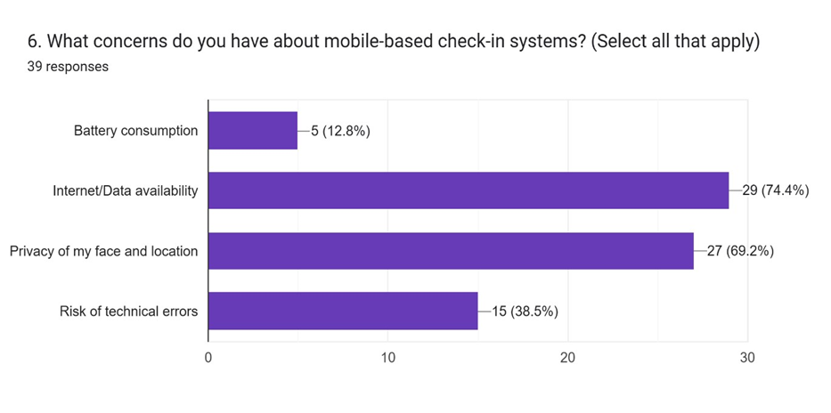
Key Survey Findings
Top Concerns:
74%: Internet dependency.
69%: Privacy.
51%: Wrongful absences.
Implications for Development:
Privacy by Design (66%)
Need for Automation(70%)
Flexible Geofencing (64%)
Mobile-Based design (79%)

Slide 17
Security & Privacy Measures
Biometric Data: Multi-Factor On-device processing + encryption.
Consent: Clear opt-in process.
Access Control: Role-based permissions (students, lecturers, admins).
Audit Logs: Track all system activities

Slide 18
Risks Assessment
Risks
Students
Lecturers
Mitigations

Slide 19
Conclusion
Solves manual attendance flaws with automation.
Balances speed (Node.js) and privacy (Django).
Next Steps: Pilot implementation at the University of Buea.

Slide 20
Thank You

